Slide 1
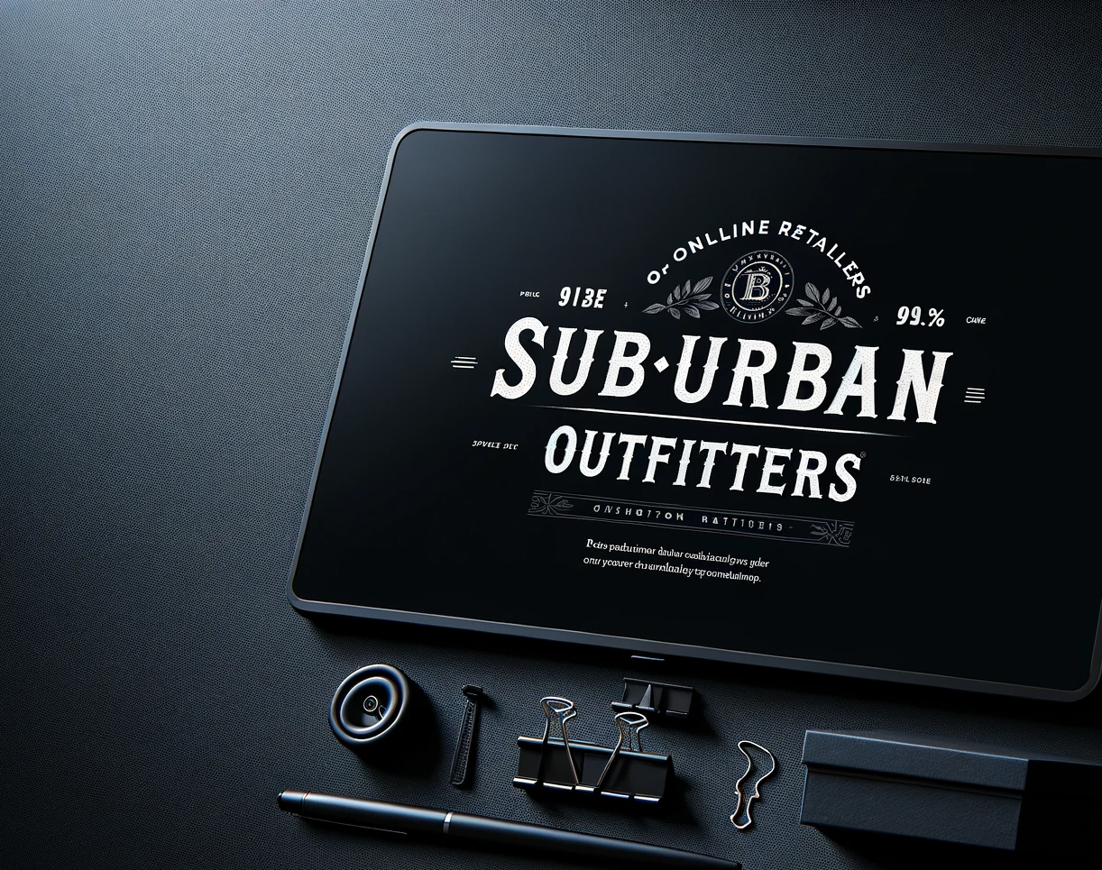

SUBURBAN OUTFITTERS ONLINE SHOPPING PORTAL
The Future of Suburban Shopping
Web Based Applications – Group 7

Slide 2
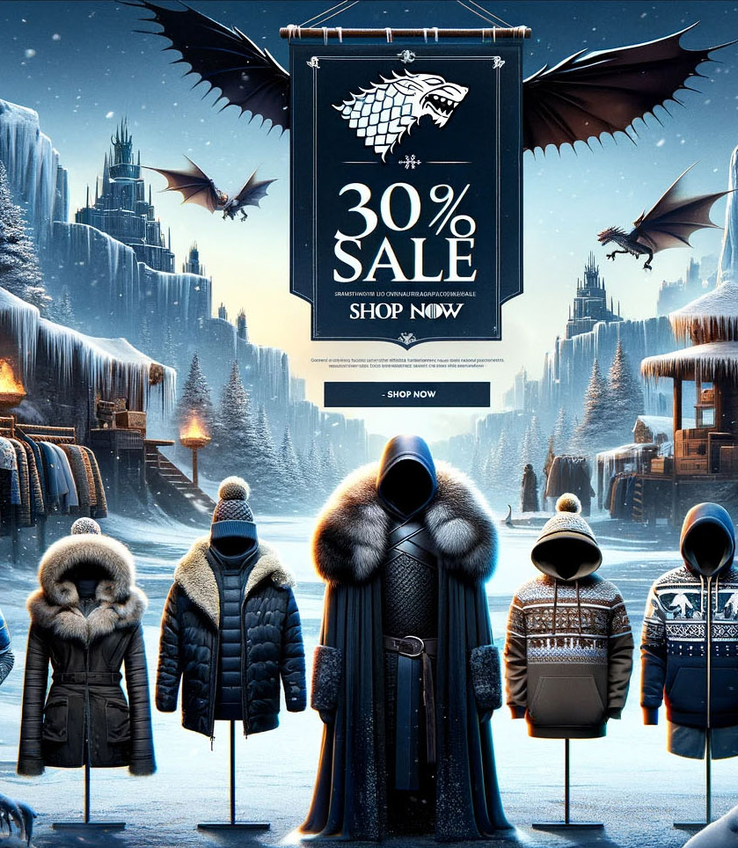
Agenda
Introduction to Suburban Outfitters
Business Use Case Model
Products and Services
UI/UX Enhancement
Customer Journey of Website
Challenges and Opportunities
Future Plans
Closing Remarks

Slide 3
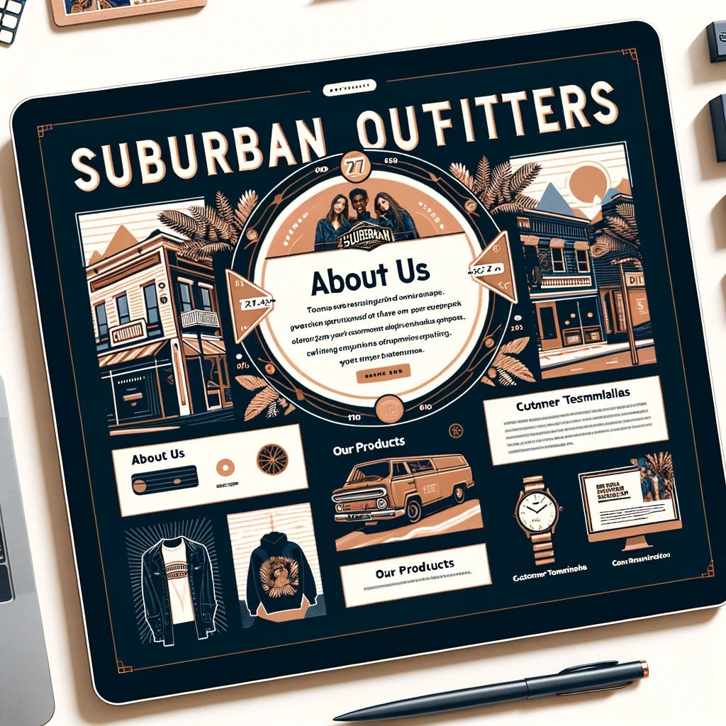
Overview of ‘Suburban Outfitters’
Development of the online store
Goals for the online shopping platform
Importance of Online Shopping
Scope of project in real-world scenario

Slide 4

Business Use Case Model
Agile System Development method adopted
Key use cases:
Customer account creation
Viewing personal details and order history
Modifying personal information
Deleting or deactivating an account
Admin roles in inventory management
Order management and processing
Shopping Cart and Wishlist management
Dynamic Website Features

Slide 5
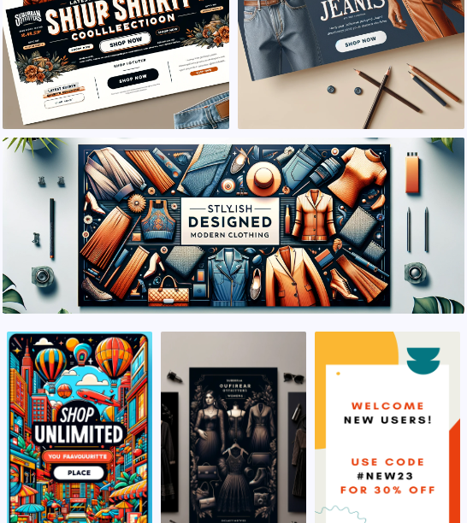
Products and Services
Wide range of products offered
Importance of product and service quality
Seasonal collections and limited-edition releases

Slide 6
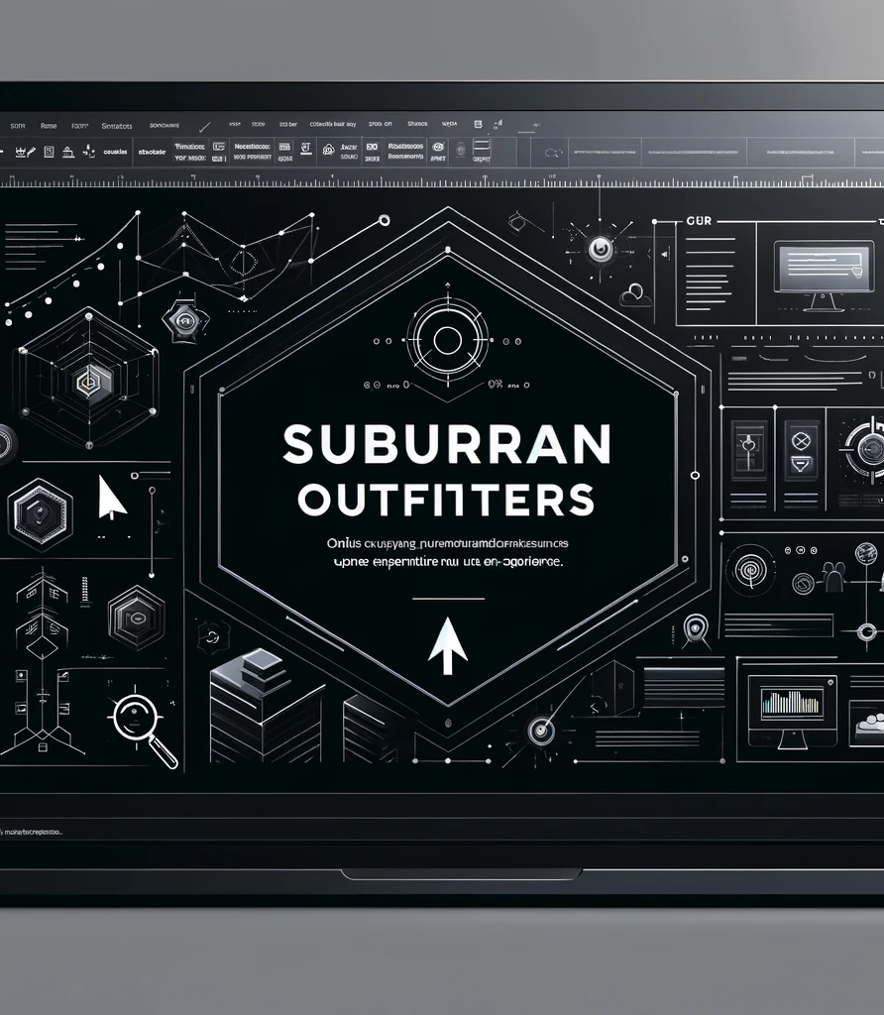
UI/UX Enhancement
Frontend technologies: HTML, CSS, Bootstrap 5, JavaScript
Backend functionalities: PHP, MySQL, WampServer
User-centric interface design
Enhancements for ease of navigation

Slide 7

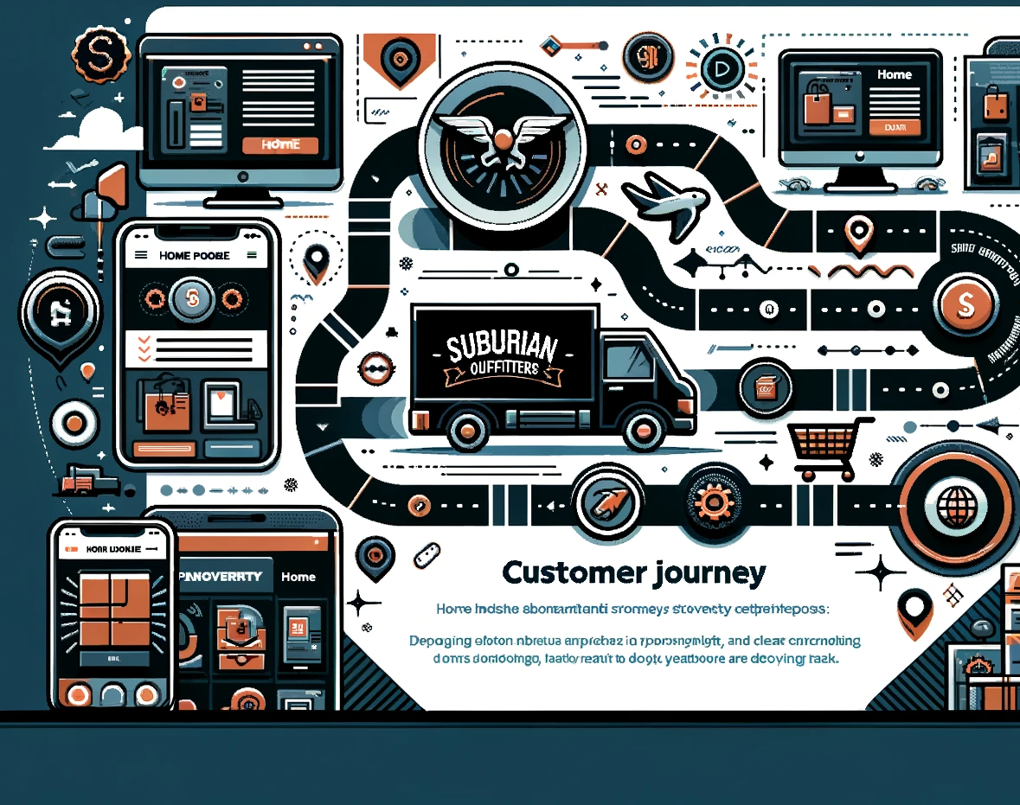
Customer Journey of Website

Slide 8

Challenges and Opportunities
Balancing user experience with technical functionality
Responsive design for various devices
Integration of real-time data
Security Protocol Restrictions

Slide 9

Customer feedback implementation
Shipping use case integration
Vendor management
Website domain and hosting

Slide 10
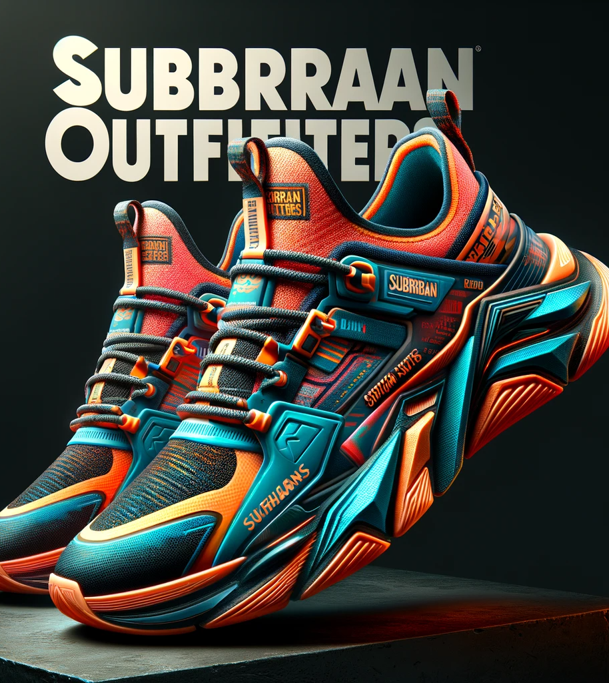
Closing Remarks
Summary of the project's aim and vision
Acknowledgment of team effort and customer value
Feedback and continuous improvement

Slide 11



